Slide 1



Predictive Analysis in Auto Insurance Claim Adjustments.
Prepared by group 13
Kavya Ravada, Sunil Joshi

Slide 2



INTRODUCTION
Problem Statement:
A key challenge in the auto insurance industry is predicting which claims will be high. High claims significantly impact insurance companies' financial stability and pricing models.
Goal:
This project aims to develop a predictive model that identifies customers likely to file high claims based on their personal and policy data. This enables proactive management and tailored customer engagement strategies.
Why It Matters:
Accurately predicting high claims can help improve risk management, personalized pricing, and customer service by anticipating needs.

Slide 3

DATASET OVERVIEW
Dataset Source and Context:
Source: Obtained from the UCI Machine Learning Repository.
Context: This dataset contains customer data related to vehicle insurance policies. It includes socio-economic information about customers and details about the insured vehicles.
Content and Structure:
Data Content: Features include categorical and numerical variables, such as socio-economic data, details about the vehicle, and the customer lifetime value based on historical data.
Use Case: The data is primarily used for clustering customers according to their purchasing behaviors, which is crucial for targeted marketing strategies and budgeting for marketing expenses.

Slide 4




Preprocessing Mastery
Defining Success:
"High Claim" acts as our benchmark, labeling claims as "high" (1) if they exceed the average amount.
Crafting Variables:
Categorical data like policy types are transformed into unique columns through One-Hot Encoding, while numerical data such as age are standardized for optimal model performance.
Engineering the Pipeline:
Our Scikit-learn Pipeline combines scaling, encoding, and modeling, ensuring seamless execution and integrity of the data throughout the training process.

Slide 5
Our exploration began with descriptive statistics to grasp the distribution of variables like income, claim amount, and policy count.
UNDERSTANDING THE DATA
Examining correlations guided us to discern impactful features crucial for predicting high claims.
Created a correlation heatmap to demonstrate the correlation between different variables visually.

Slide 6
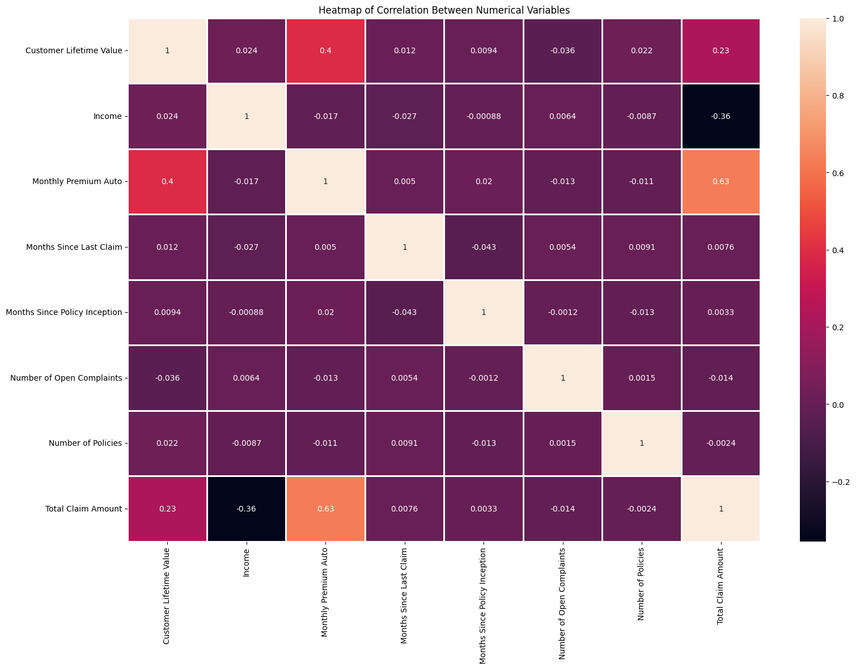

Slide 7
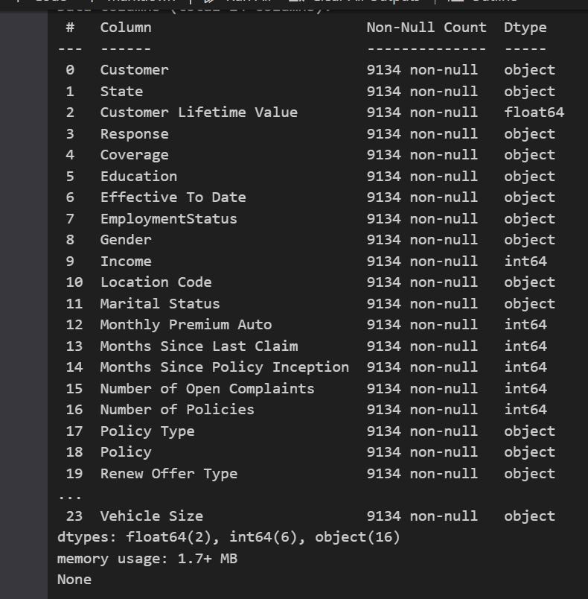
Ensured data quality by checking for missing values.
An inherent advantage of our dataset is the absence of missing values.
This cleanliness ensures that data gaps do not impede our analysis and modeling processes.

Slide 8


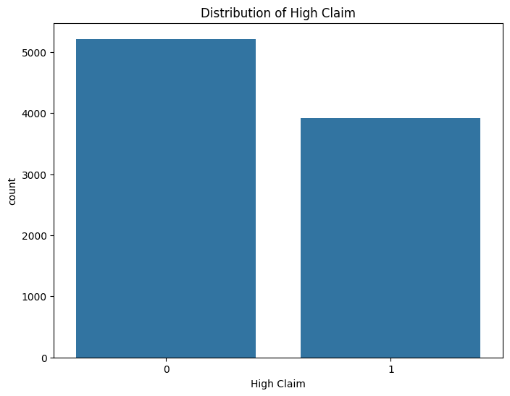

Bar Graph

Slide 9

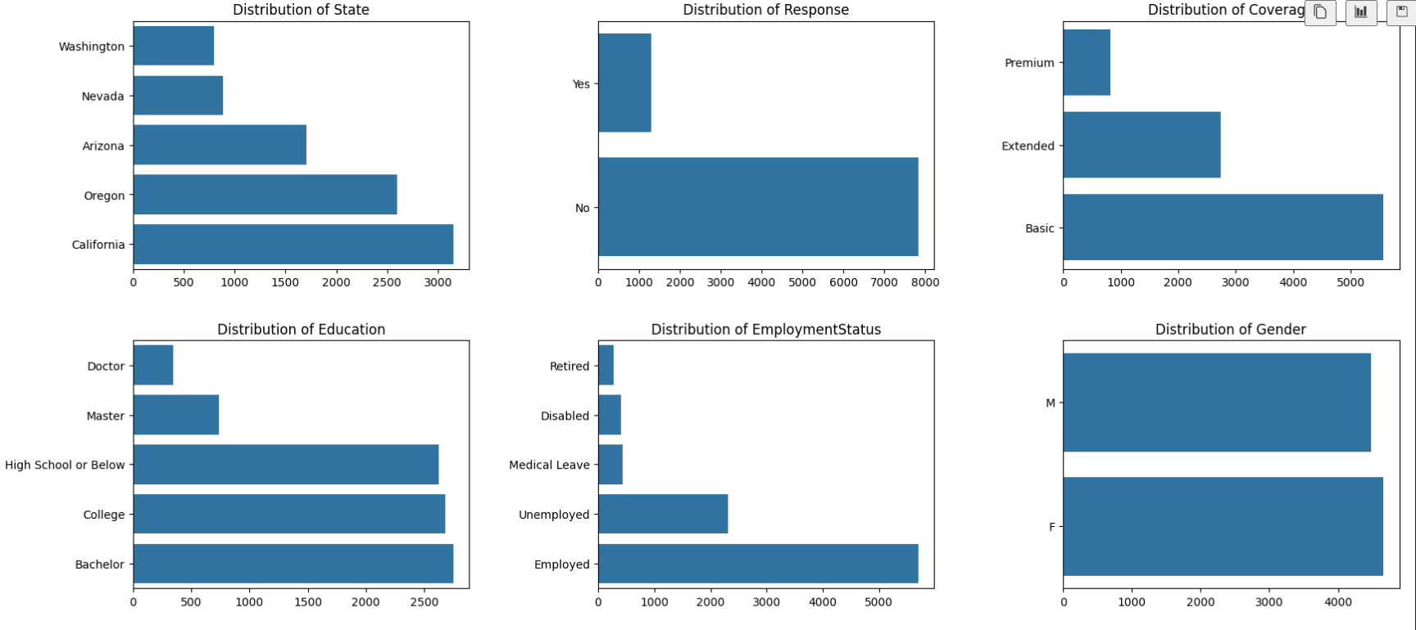
Horizontal Bar Plots

Slide 10
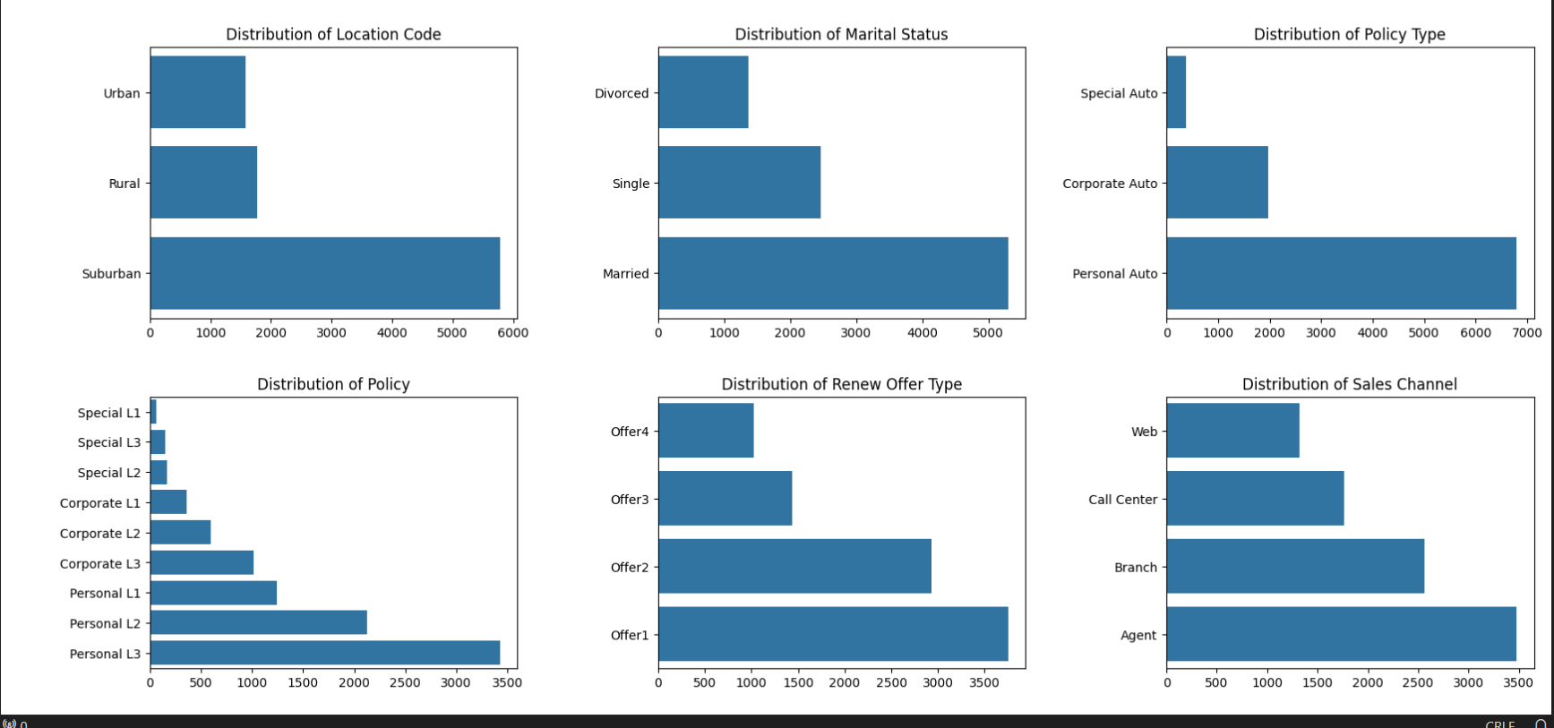

Slide 11
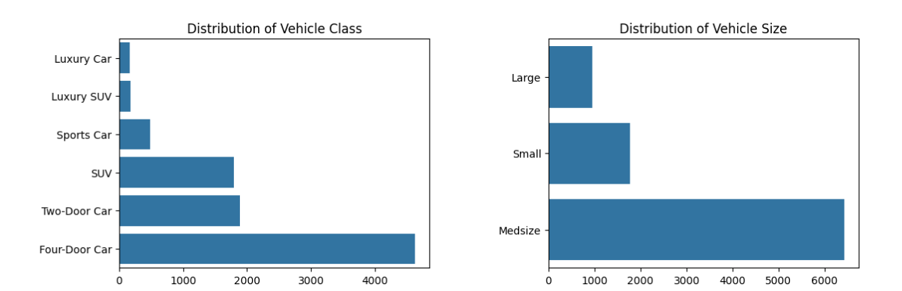

Slide 12
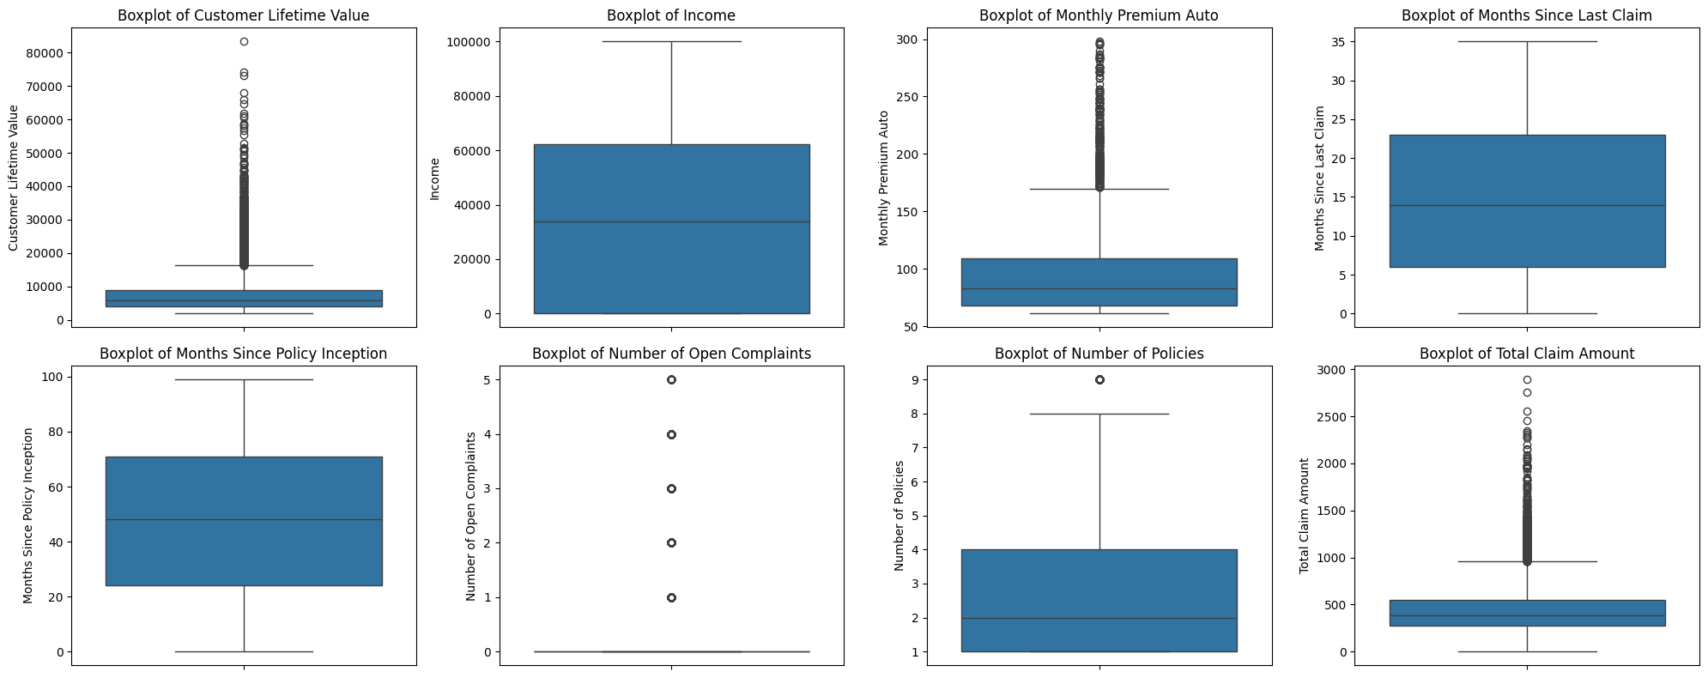
Box Plots Visual Overview: Box plots were used to visualize our dataset's continuous feature distribution. By displaying the range and distribution of the data, box plots effectively highlight the presence of outliers.

Slide 13



PROJECT OBJECTIVES
Models Used:
Why These Models?
Expected Outcomes:
Random Forest Classifier
Gradient Boosting Classifier
AdaBoost Classifier
XGBoost Classifier
Handling Non-Linear Data
Feature Interactions
Robustness
Scalability
To achieve high accuracy in predicting high claims.
To improve the interpretability of model results for strategic business applications.

Slide 14

MODEL EVALUATION SUMMARY
Model Performance:
Random Forest: Accuracy - 89.87%, ROC-AUC - 96.85%
Gradient Boosting: Accuracy - 89.87%, ROC-AUC - 96.52%
AdaBoost: Accuracy - 88.23%, ROC-AUC - 95.65%
XGBoost: Accuracy - 89.38%, ROC-AUC - 96.85%
Significant Findings:
Random Forest and XGBoost models excel with the highest accuracy and ROC-AUC scores.
AdaBoost shows a slight dip in performance, potentially due to its approach to combining learners.
Consistently high precision and recall scores across models suggest a balanced prediction capability.

Slide 15
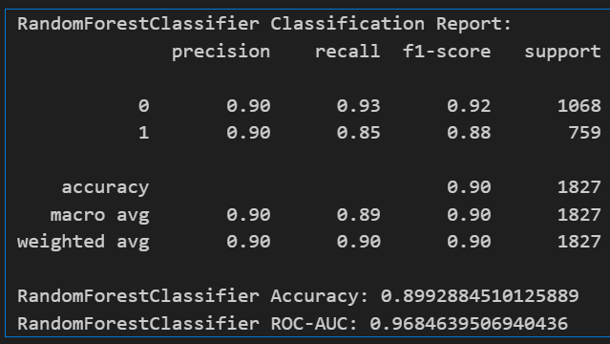
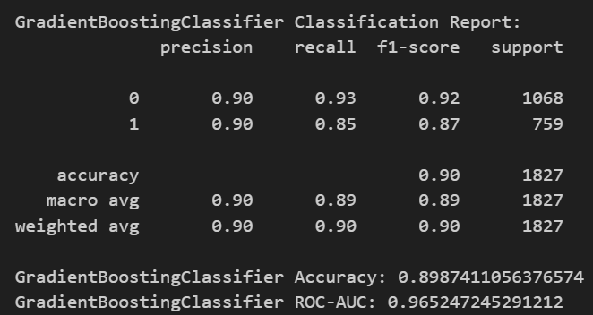
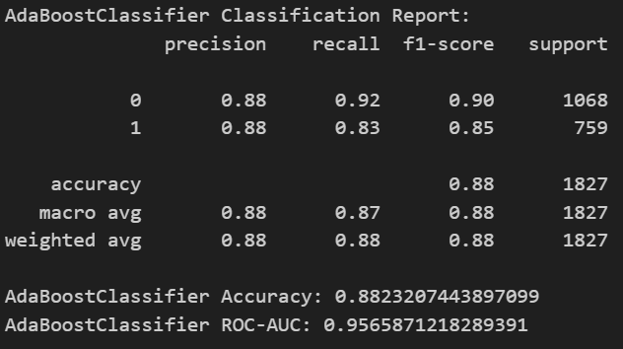
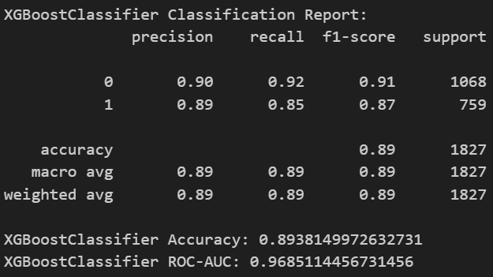

Slide 16
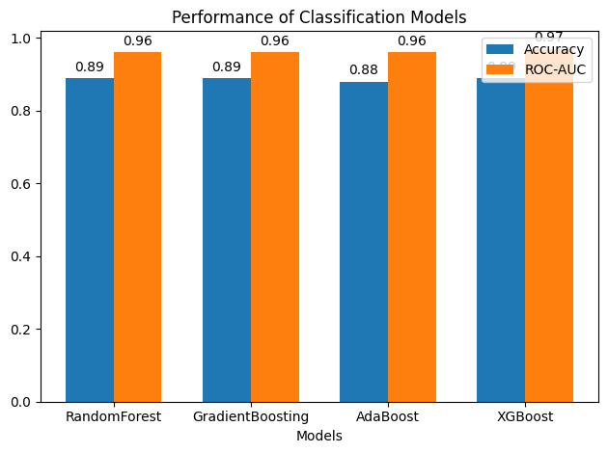
To determine the best model, we focus on two main metrics: Accuracy and ROC-AUC
CONCLUSION
Our models have shown high accuracy and solid predictive abilities, a testament to robust data and practical algorithms.
The success of ensemble methods, particularly Random Forest and XGBoost, highlights the power of combining multiple learning models.

Slide 17
THANK YOU

